Slide 1

Complaint Redressal System

Slide 2
GROUP - 08
FRONT END
Shinde Nikita Navanath 2486701
Vemula Poornima 2487155
Shreya K S 2486997
Umme Hani R 2487435
Yerasi Gopinatha Reddy 2483780
BACK END
Tariq Mohommed Sarfaraz 2486600
Sparsha Gowda G 2487717
Yakkanti Chinnapareddy 2484070
Vishwanath Mangond 2484912
Tanmay Ajeet Kumar 2482282

Slide 3
CONTENTS
Introduction
Objective
Modules for Complaint-Redressal-System
Tools & Languages Used
System Requirements
Features Available
Admin Flow & User Flow
Screen Shots Of Output
Future & Scope Improvements
Conclusion

Slide 4
COMPLAINT REDRESSAL SYSTEM
INTRODUCTION:
Online complaint redressal system provides an online way of solving the problems faced by customers by saving time.
The proposed complaint redressal system will be capable of taking care of the following activities :
Customer can post the complaints in the site and get them solved in a specified time and can also know the status of the complaint he has raised.
Alert the concerned higher authority in case of escalation.
The customer can enquire about the status of the application at any time .

Slide 5
Objective:
The objective of the complaint redressal system is to make complaints easier to coordinate, monitor, track, and resolve.
To make company with an effective tool as identify and target problems areas, monitor complaints handling performance.
Complaint redressal system is a technique for responding to customer complaints.
Complaint redressal system is used to record resolve and respond to customer complaints, requests as well as facilitate any other feedback.
Develop a complaint redressal system which will help in managing complaints or applications received from customers.
Facility at centralized location to review the status or update the status.

Slide 6
Modules for Complaint Redressal System:
Home
Admin
Customer
Manager
Engineer
Feedback
About Us
Contact Us

Slide 7
ADMIN MODULE:
In this module the admin have to login with the credentials if the credentials are wrong it will show the popup window that credentials are wrong. Once the admin has given correct details it will redirect to next page. After logging in admin can view customer, manager, engineer, complaints and feedback. Admin can update or delete.
CUSTOMER MODULE:
In this module customer can register and after logging in the customer has the ability to post the complaint and he can view the status of the complaint that he has raised and he can also provide feedback to the specific complaint.

Slide 8
MANAGER MODULE:
In this module manager needs to login with his id and password after logging in, the manager can view the complaint that has been given by the customer and he can assign a particular engineer to solve that issue. And he can also view status that engineer has given and also he can view the feedback report that the customer has given.
ENGINEER MODULE:
In this module needs to register with the credentials and after logging in he can view the complaint and he can resolve the issue and can update the status and also he can view the feedback report that the customer has given.
.

Slide 9
Advantages:
Acknowledgement and Communication:
Effective acknowledgement and ongoing communication goes a long way towards making your customer feel valued.
Accountability:
It may helpful to have the capability to escalate a complaint to a manager.
Security:
Keeping customers info private and safe.
Awareness cannot be denied:
The company cannot claim that they were unaware of the complaint.

Slide 10
Disadvantages:
Lack of procedure:
Inconsistency can lead to confusion and ineffective communication between agents, managers and customers.
Late resolution:
A complaint that is resolved weeks or even months after it’s received paves the way for further customer dissatisfaction and new complaints about how long it takes to resolve issues.

Slide 11
System Requirements :
The Basic System Requirements for Running this project are listed below:
Angular, STS and MySQL to be installed to the system
572 MB Random Access Memory
200 MB of Free Space on Hard Disk
Microsoft Windows XP or Linux or Equivalent OS
Web Browser Internet Explorer Version 10

Slide 12
Tools & Languages Used :
Front End
Visual Studio
Angular
Html
CSS
BOOTSTRAP
Back End
MySQL
Spring Tool Suite
Eclipse IDE
Spring Boot

Slide 13
Features Available :
Customer
Register
Login
Complaint
Send Feedback
Logout
Admin
Login
View Manager
View Engineer
View Customer
View Complaints
View Feedbacks
Update And Delete

Slide 14
Features Available :
Manager
Register
Login
View Complaints
View Feedbacks
Assign Engineer
Logout
Engineer
Register
Login
View Complaint
Resolve issue
Update status
Logout

Slide 15
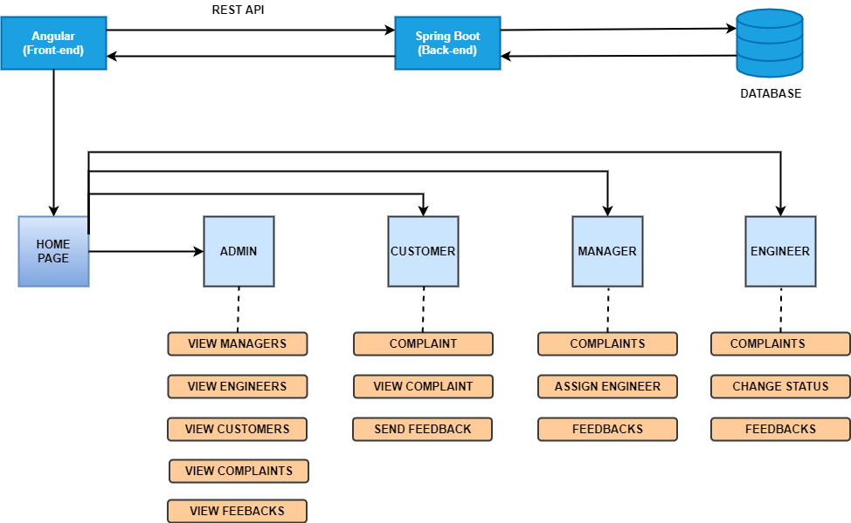
APPLICATION FLOW

Slide 16
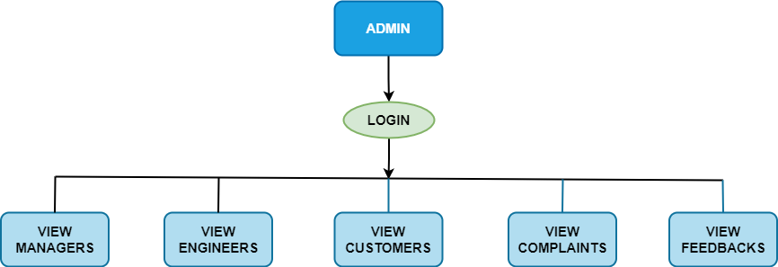
ADMIN FLOW

Slide 17
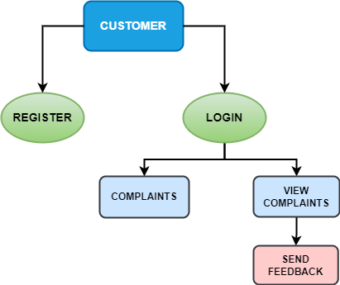
USER FLOW

Slide 18
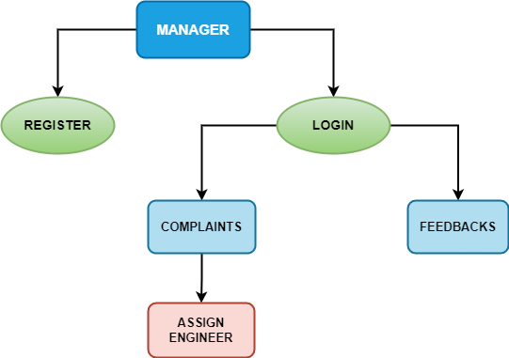
MANAGER FLOW

Slide 19
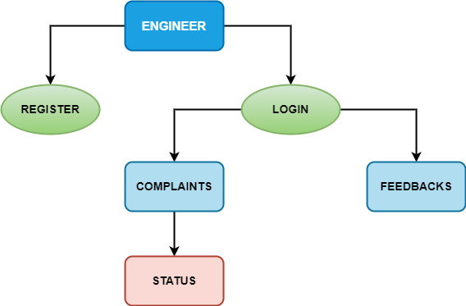
ENGINEER FLOW

Slide 20
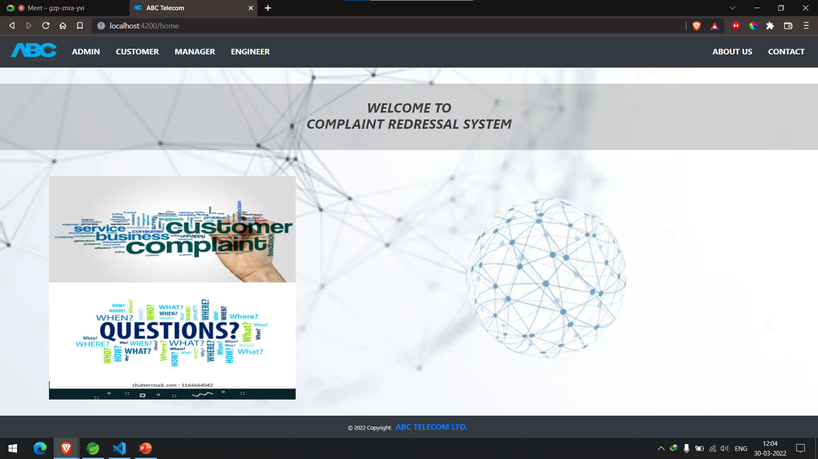
SCREENSHOTS

Slide 21
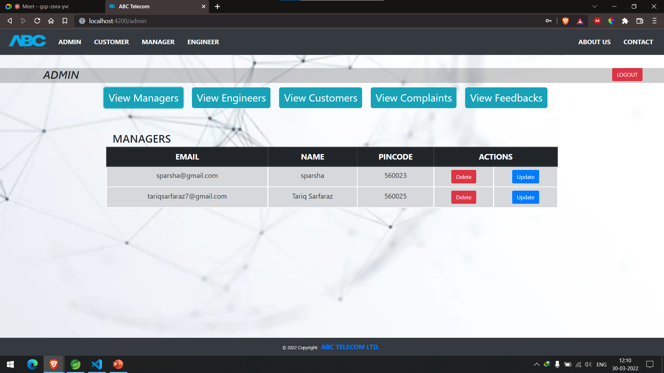

Slide 22
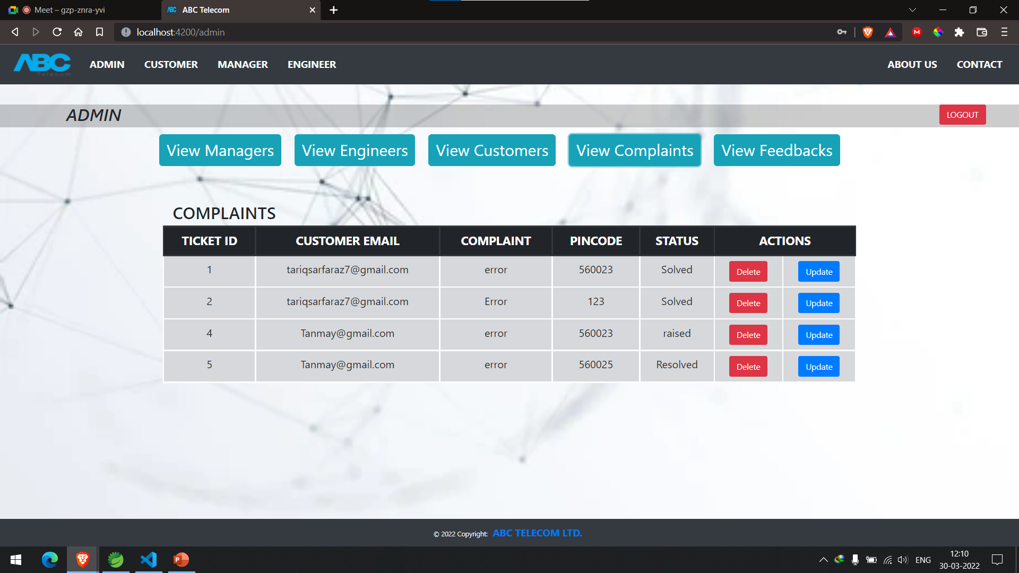

Slide 23
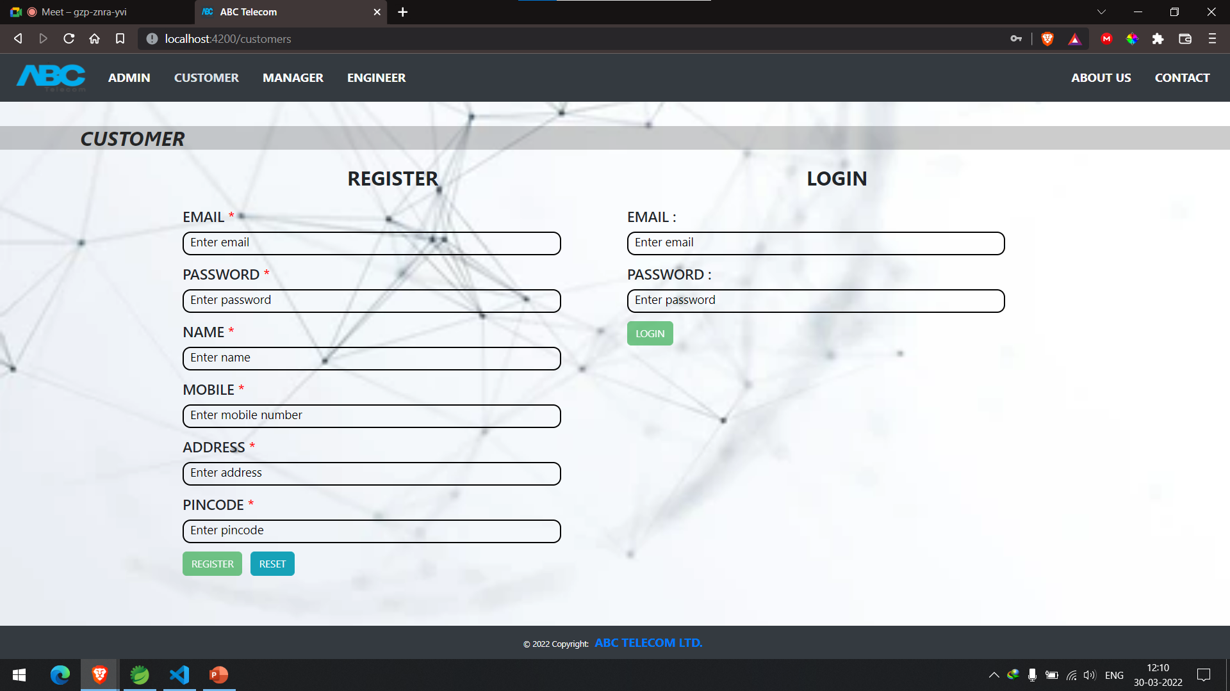

Slide 24
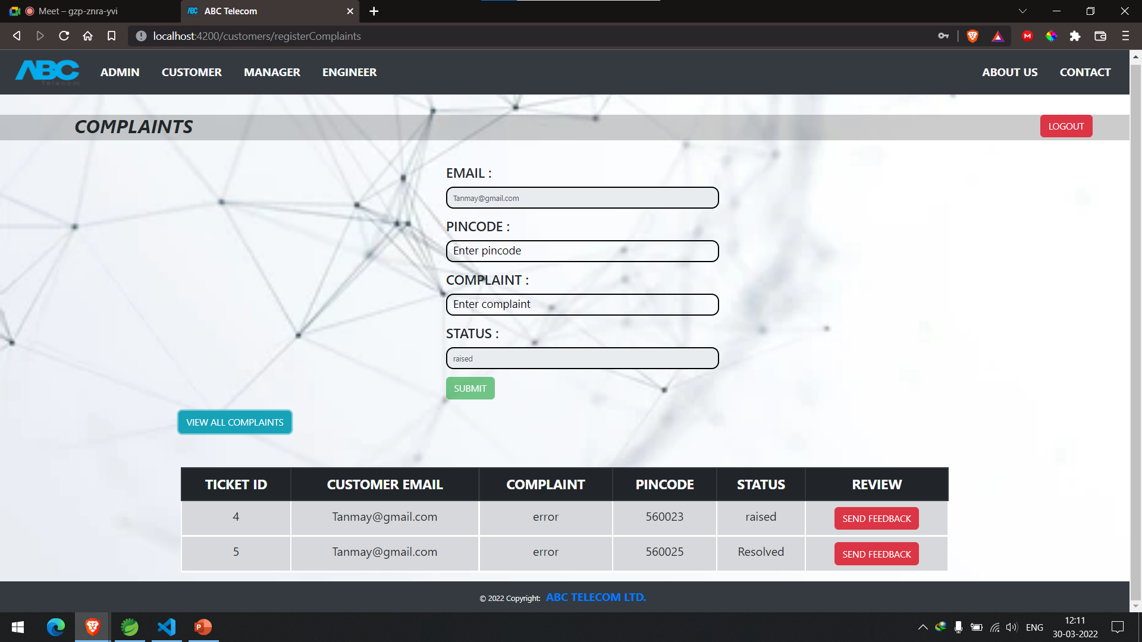

Slide 25
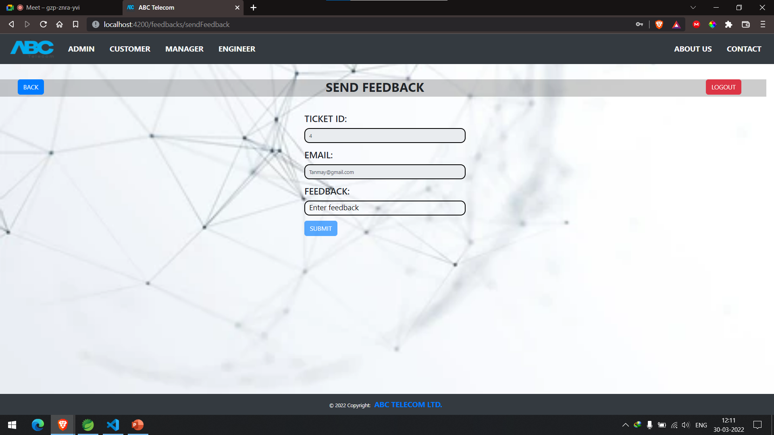

Slide 26
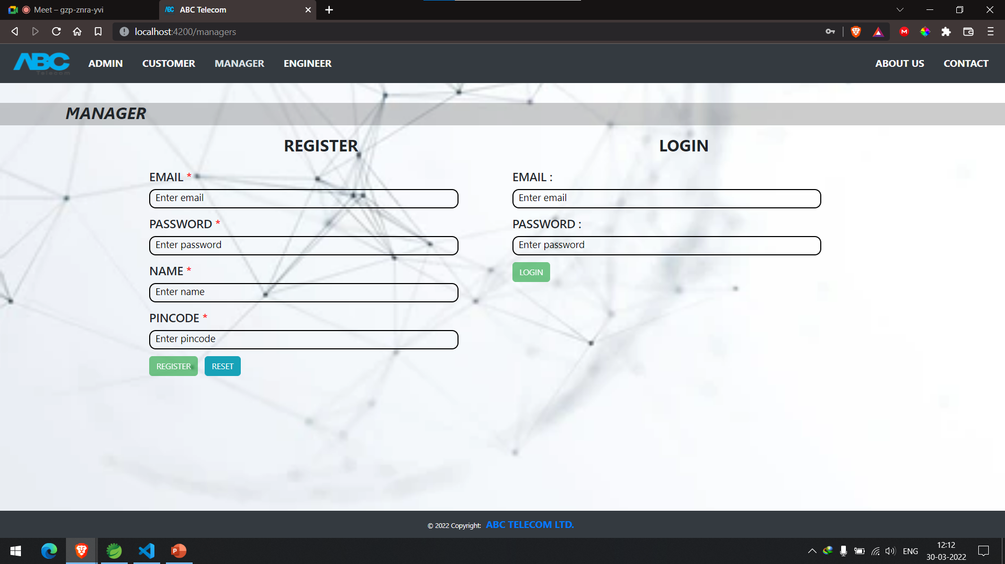

Slide 27
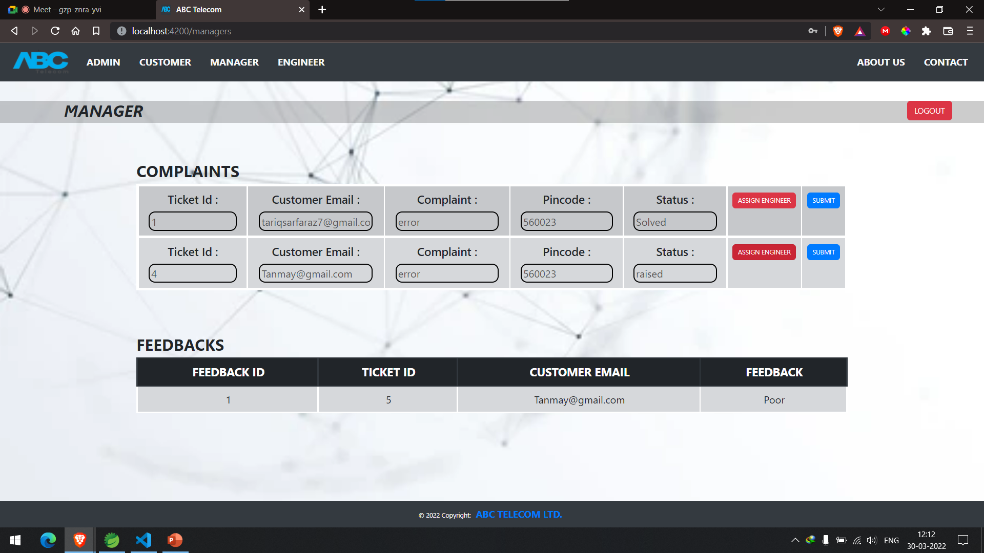

Slide 28
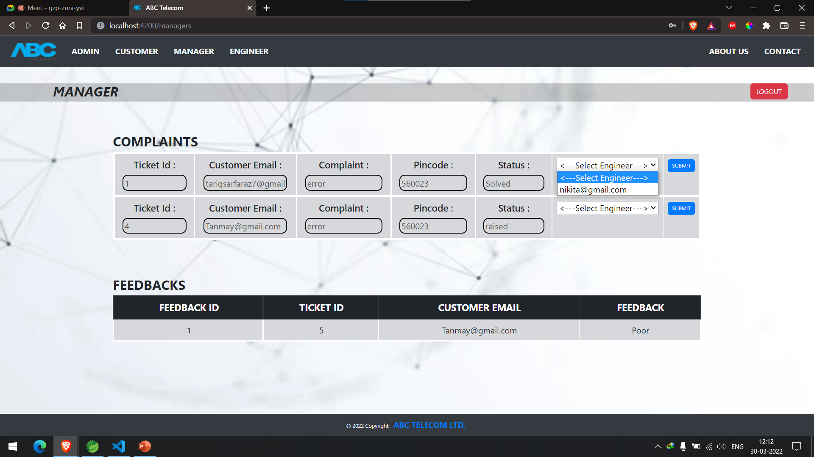

Slide 29
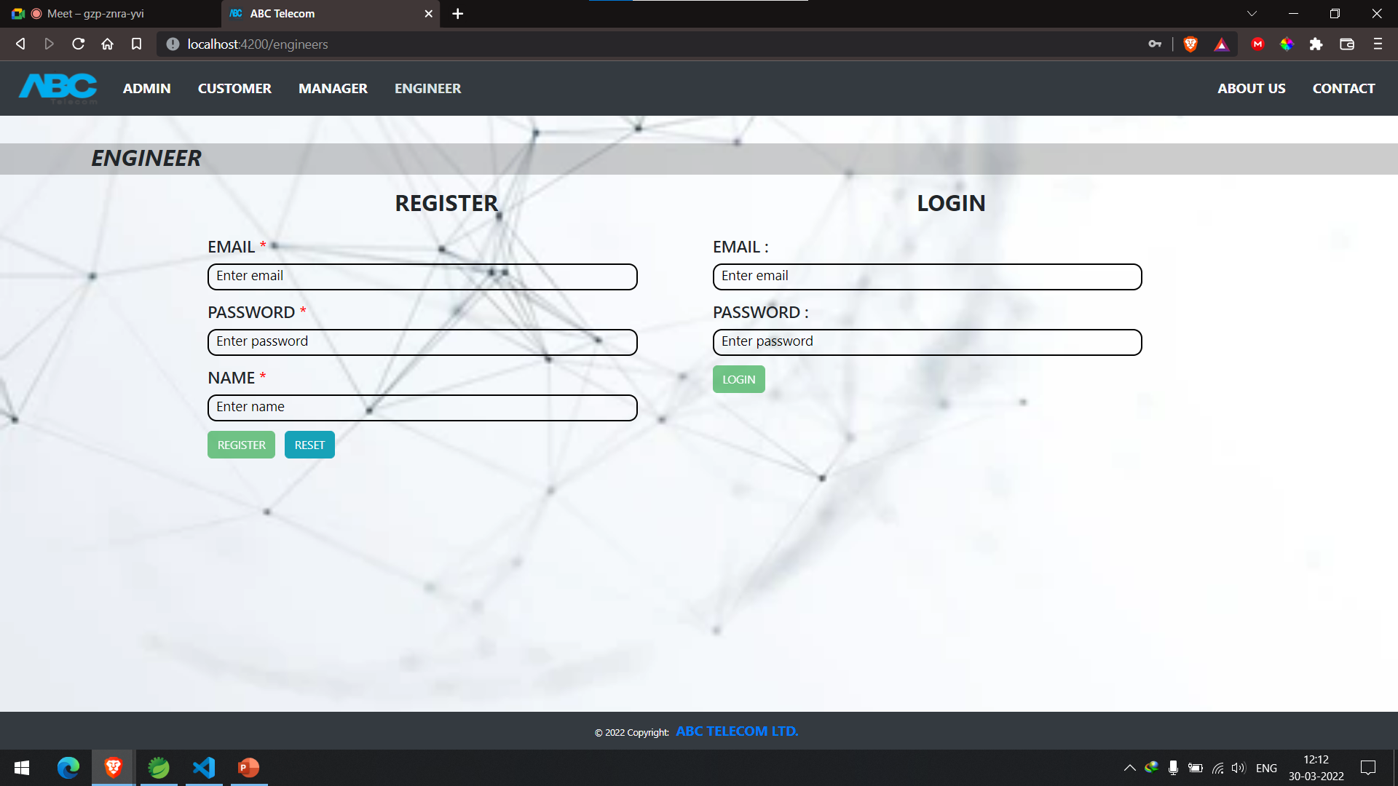

Slide 30
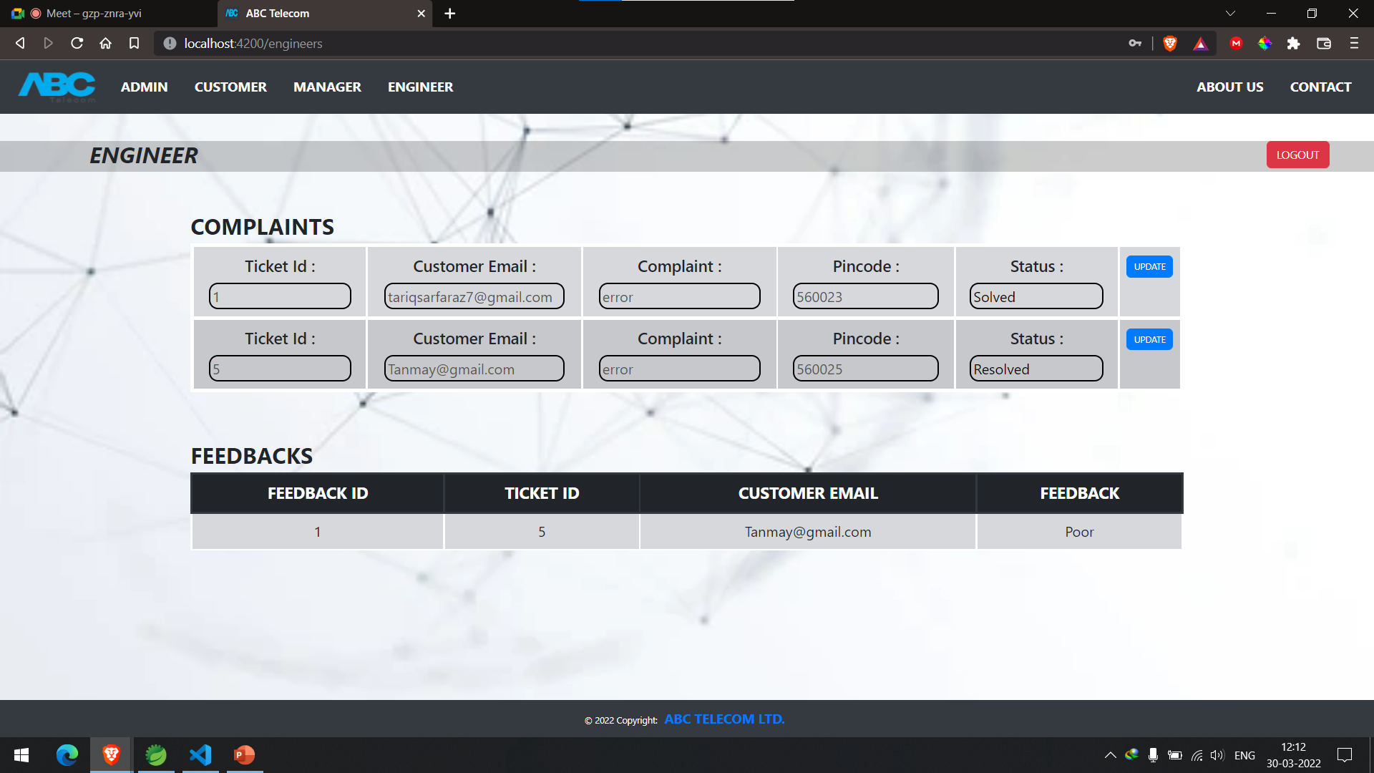

Slide 31
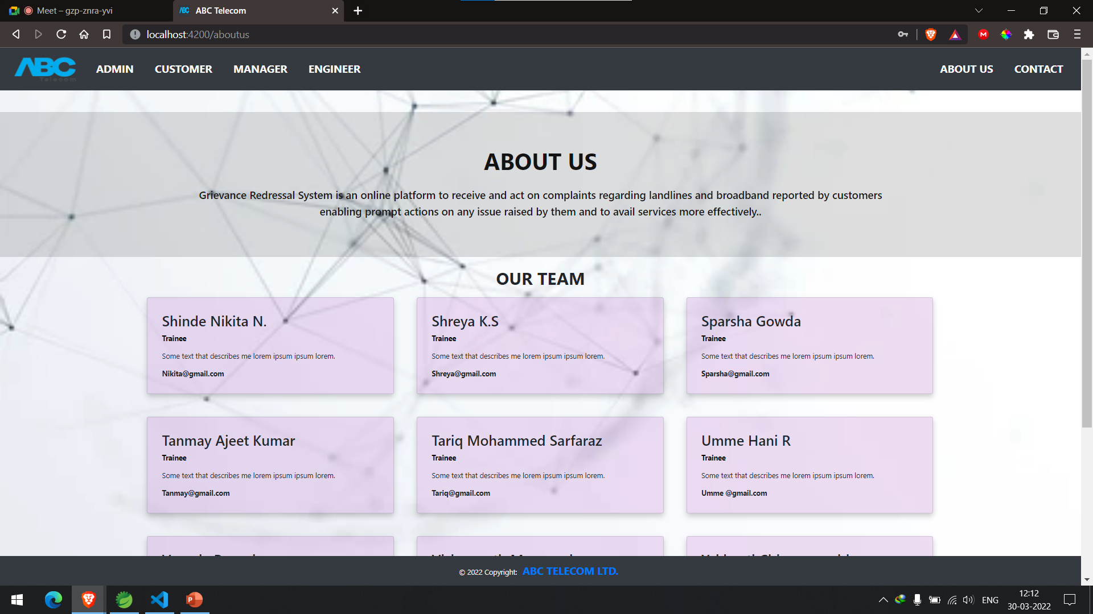

Slide 32
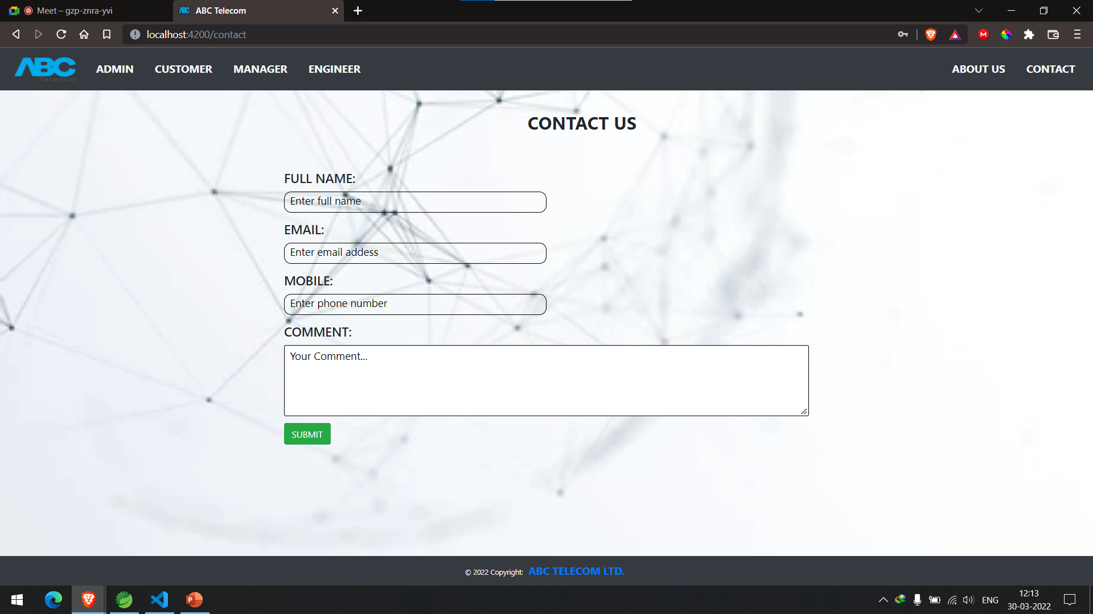

Slide 33
Future & Scope Improvements :
Complaint Management has always be strategic in Customer Relationship Management.
It pursues two main objectives : the improvement of the customer satisfaction and the improvement of the products/services and processes of an organization (processing complaints leads to the identification of the root causes and the implementation.
The stakes can be identified where technology is today involved:
1) The categorization of complaints
2) The identification of the critical complaints
3) The routing of the complaints
4) The resolution of the complaints & capitalization of the solution
5) The complaints handling management
6) The measure of the client satisfaction
7) The evaluation & analysis of the performance of the complaint management process on of corrective & preventive actions.

Slide 34
Conclusion:
The system has the benefits of easy access because it is be developed as a platform independent web application, so the admin can maintain a proper contact with their users, which may be access anywhere . All communications between the client/user and administrator has done through the online, so this communication cost also be reduced.

Slide 35


